Slide 1
Grad Cave
12-October-2021
Somya Agarwal | somyaa@andrew.cmu.edu
Shivani Poovaiah Ajjikutira | sajjikut@andrew.cmu.edu
Kristi Kunworee Baishya | kbaishya@andrew.cmu.edu
Kanishka Amar Bhambhani | kbhambha@andrew.cmu.edu

Slide 2

AGENDA
Vision
Team
Problem
Approach / Solution
Market
Business Model
Competition
Go-to-Market
Project Insights

Slide 3

VISION
Delivering hassle free and cherishable experience for students setting foot in the study haven of U.S

Slide 4
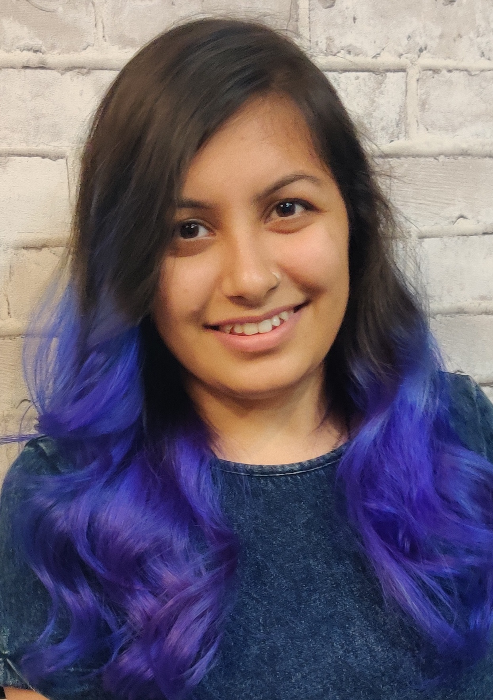
TEAM
Name : Kanishka Bhambhani
linkedin.com/in/kanishkabhambhani
Title : C.E.O
Experience : Product Developer with three years of experience at SAP Labs India. Developed micro-services for SAP Cloud with sound knowledge in design, analysis and development using competing technologies to manage business processes in an organization’s ecology.

Slide 5
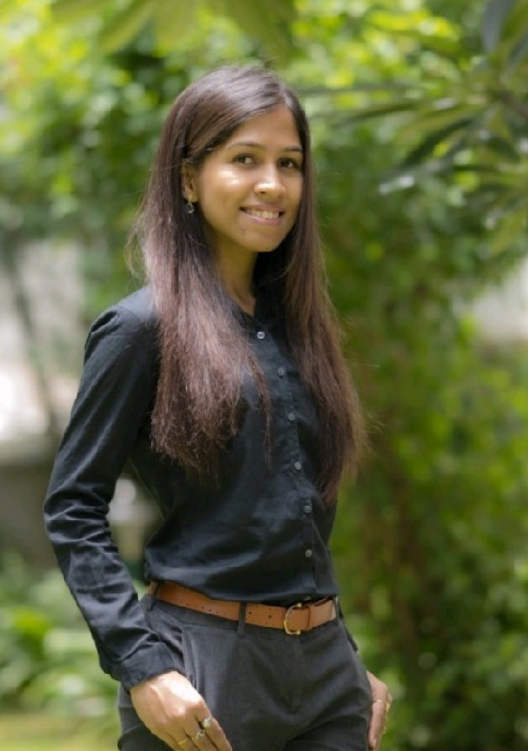
TEAM
Name : Kristi Kunworee Baishya
linkedin.com/in/kristi-kunworee-baishya-699b9266
Title : C.D.O
Experience : Data Science Manager with 5 years of expertise in the application of predictive data modeling, statistical data modeling and business intelligence to deliver insights and implement action-oriented solutions to complex business problems.

Slide 6
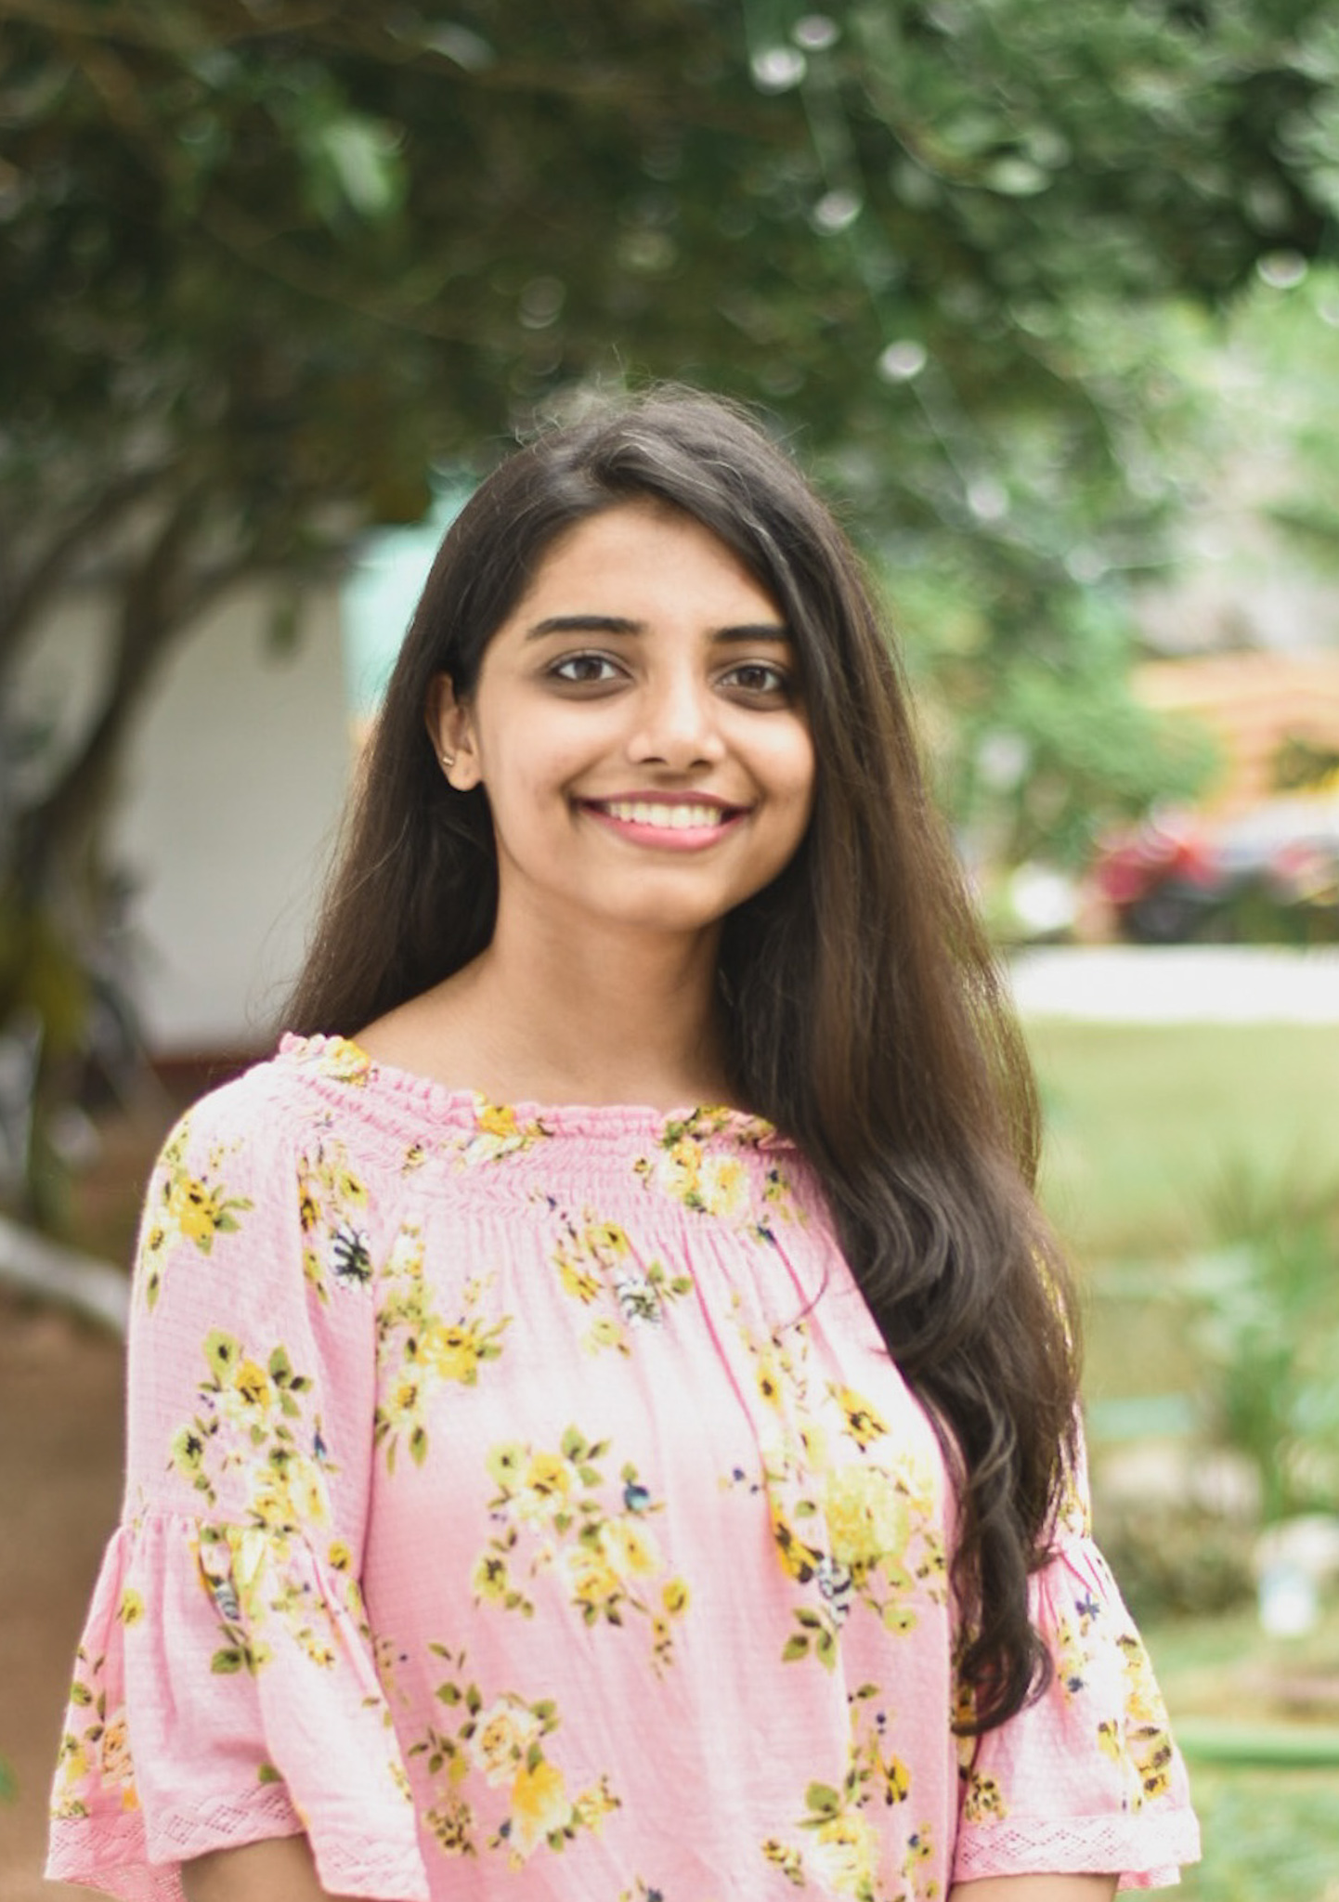
TEAM
Name : Shivani Poovaiah Ajjikutira
linkedin.com/in/shivani-poovaiah
Title : M.D
Experience : Analyst at Deloitte USI with close to 2 years of experience in Front-end Web Development. Developed websites for B2C clients using frameworks/languages like VueJS, Vuex, JavaScript, jQuery, HTML and CSS integrated with SAP Hybris on the backend.

Slide 7
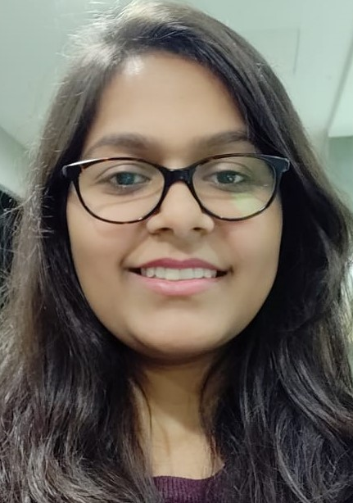
TEAM
Name : Somya Agarwal
linkedin.com/in/somya-agarwal-22004315b
Title : C.T.O
Experience : Data Analyst with 5 years of experience in providing data driven solutions. Skilled in Python programming, SQL and web-scraping with Selenium

Slide 8


PROBLEM - CUSTOMER PAIN
Lack of knowledge of apartments and prospective flat mates' lifestyle choice
Students at the mercy of landlords’ rent demands as opposed to student-oriented rates
Lack of knowledge of security profile of the neighborhood

Slide 9



PROBLEM-CUSTOMER PAIN
A one stop platform to find a suitable, furnished and utility provided place to stay within student-oriented budget
Monthly or annual subscription fee, or a one-time payment to explore residence options. Plus 15% of first month’s rent agreed upon once agreement signed
Lack of suitable programmers to maintain the integrity of app at back end, lack of support staff to take care of one-on-one consultation

Slide 10



SOLUTION / PRODUCT
The GradCave application is a boon for the student community, they can easily find or manage a place to stay in Pittsburgh, based on their preferences.
One-stop platform to meet all requirements (affordability, proximity and safety)Web-based as well as mobile application
Students can end up paying 1.5 to twice of average rent (no market mechanism to control rent rates)

Slide 11
MARKET
Target audience: students moving to Pittsburgh for undergraduate and graduate programs
The total student population at Pittsburgh is 84,440. The proportion of undergraduate students is 72.81%(61,477 students) and that of graduate students is 27.19%(22,963 students).
Source: https://www.collegetuitioncompare.com
Market drivers include:
Social drivers: Student lifestyle preferences
Economic drivers: Budget friendly
Technological drivers: Mobile/websites

Slide 12

BUSINESS MODEL / UNIT ECONOMICS
How does your company make money?
Free trial for 1st Month
Advertising
Food Joints and Events
Tie-ups with Event & Housing Managers
Kiosks in Universities
Referral
Marketing
Collaboration with Property Consultants

Slide 13
BUSINESS MODEL / UNIT ECONOMICS
Pricing details
Considering all the factors from the previous slide the pricing of the product via customers if their lifespan is for about three months then the revenue generated would be approximately 50$/customer.
Include metrics, e.g.:
Average Order Value (AOV)
AOV = Total Revenue generated by Grad Cave/No. of Customers
= 25000/1000 = 25$
Note : Here the consideration is that the revenue generated via each customer is 25$/month and there are 1000 subscribers for the application
Lifetime Value (LTV)
The avg sales of a particular month is close to 25$ and if a customer is using the application for three months (including the month where the application is free) the total lifetime value would be 25*2 = 50$

Slide 14





COMPETITION
Key competitors are housing recommendation websites like Apartments.com, Zillow, Realtor, Trulia, etc.

Slide 15



COMPETITION
Advantages of choosing GradCave:
Locality safety information based on crime rates
Distance from the university campuses
Timely notifications about the events nearby

Slide 16
LAUNCH STRATEGY / GO-TO-MARKET
Social Media Awareness
Digital Content
Product Demos
Online Offers and Deals
Customer Acquisition Approach:
Market Strategy
Acquiring Customers
Visitor
Potential Lead
Customer
Active User

Slide 17
LAUNCH STRATEGY / GO-TO-MARKET
What are key drivers and potential milestones?
Analyze the market for students based on the historical data.
Analyze the timeline where in the application would be used to its maximum potential.

Slide 18
LAUNCH STRATEGY / GO-TO-MARKET
Milestones:
The early milestone would be to strategize the design of the application and collect data from various websites to hit the market at the golden time.
Constantly maintain the relationship with the customer for the first few months in order to analyze their options and probably make predictions based on the same.

Slide 19
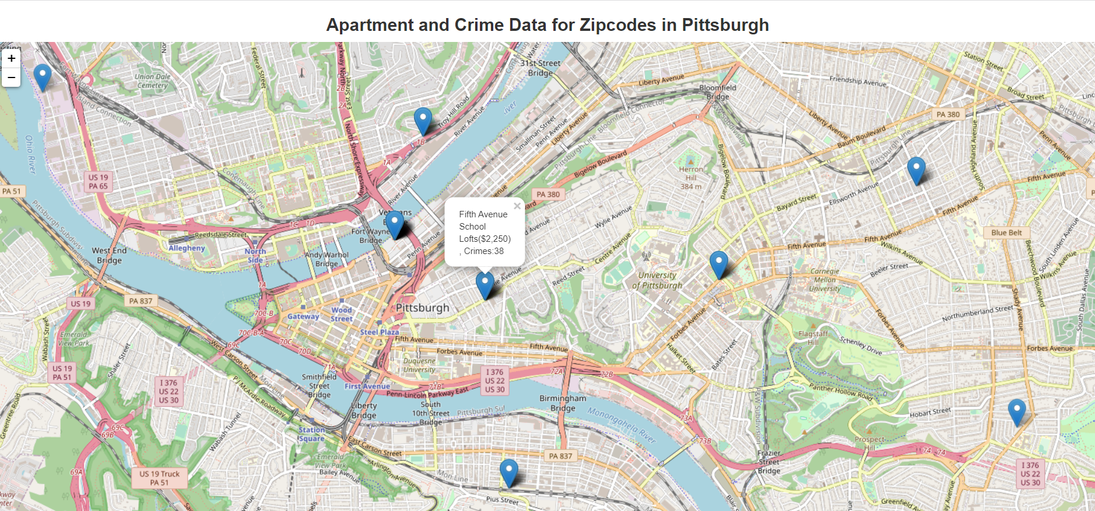
Project Insights:
The user gets to see the apartments closer to his area and along with it the crime rate in that area

Slide 20
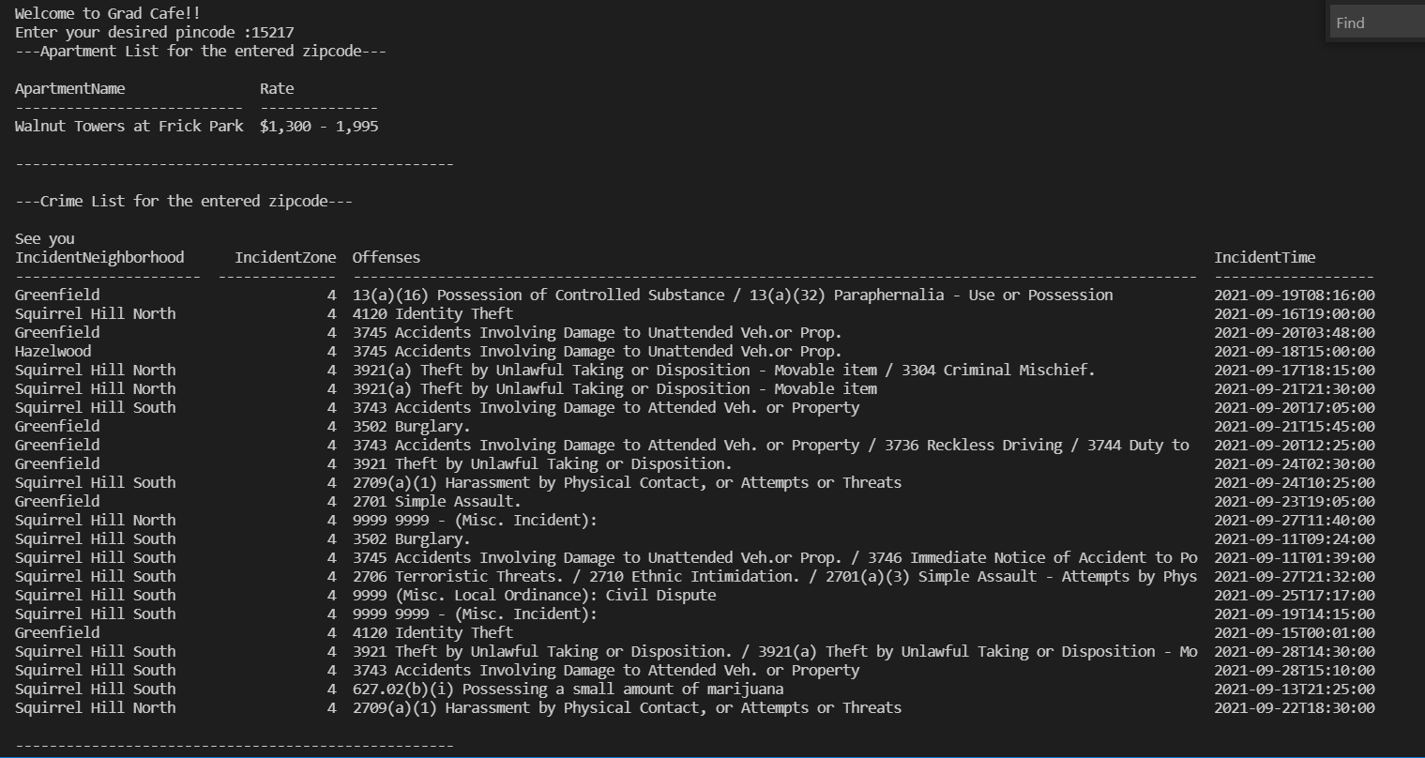
User Interaction:

Slide 21
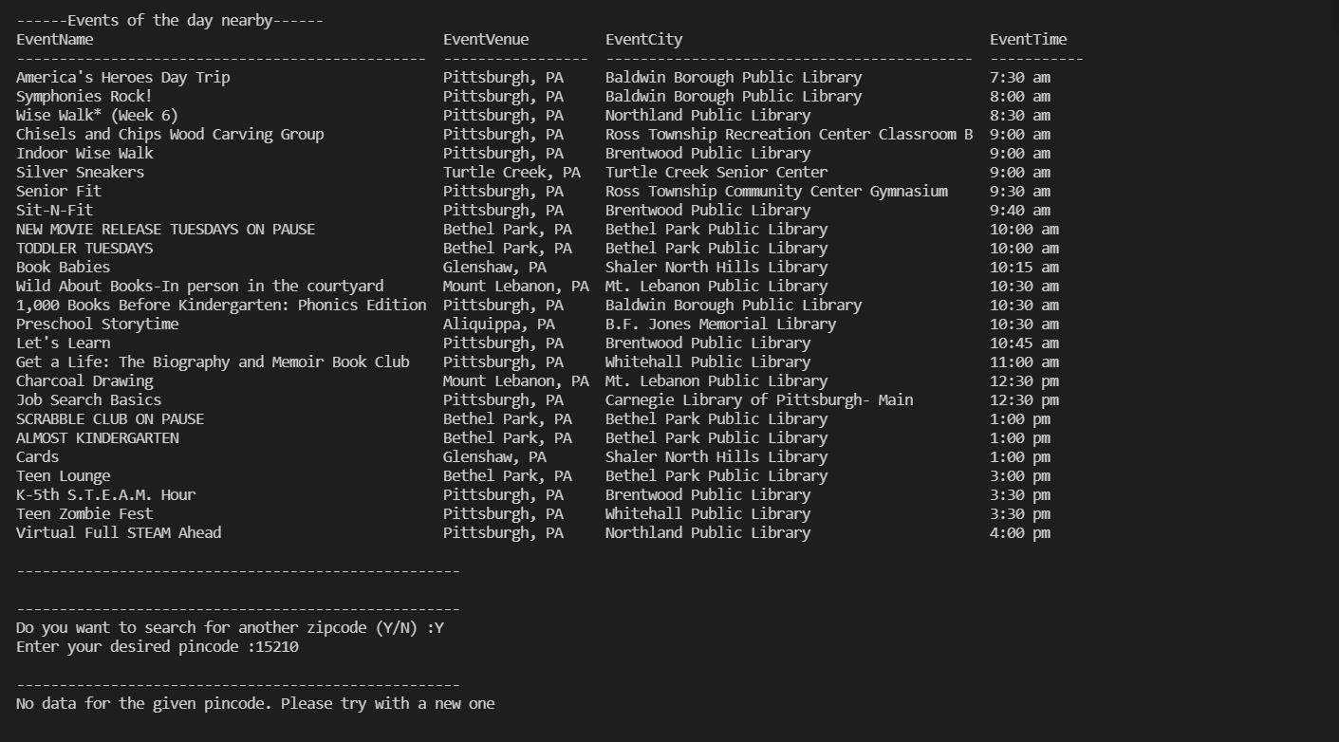
User Interaction:

Slide 22
Thank You! ☺

